Slide 1
Recurrent Neural Networks (RNNs)
Deep Learning Fundamentals
Notes:
Introduce the topic of Recurrent Neural Networks, explaining that RNNs are a type of neural network designed to handle sequential data. Provide examples of sequential data, such as time series data or natural language processing. Ask students what they know about neural networks and how they can be applied to real-world problems.

Slide 2
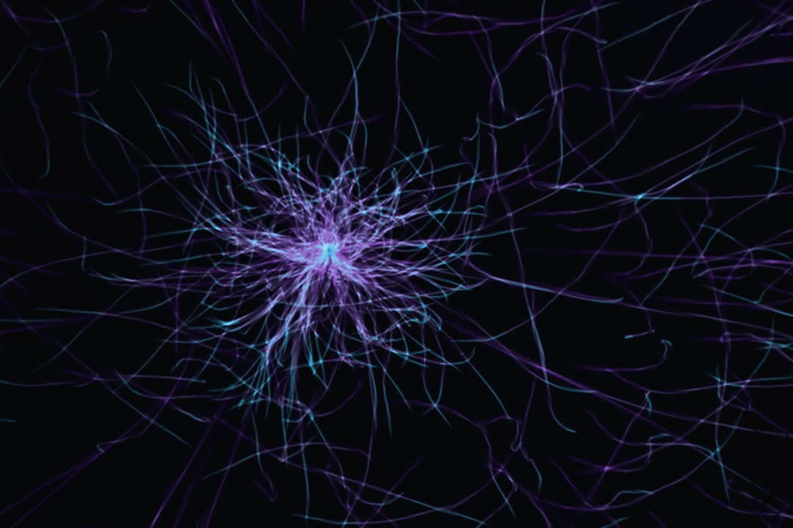
Intro/Background
RNNs handle sequential data
Designed for time series forecasting
Natural language processing applications
Speech recognition and synthesis
Image captioning and generation
Handle variable-length input sequences
Can learn long-term dependencies
Key component in many deep learning models
Used in chatbots and virtual assistants
Enable machines to understand human language
Notes:
Explain the importance of RNNs in handling sequential data, providing examples of applications such as natural language processing and time series forecasting. Discuss how RNNs can learn long-term dependencies and handle variable-length input sequences. Ask students to think of real-world applications where RNNs can be used, such as chatbots or virtual assistants.

Slide 3
Architecture
Consist of input, hidden, and output layers
Hidden layer has recurrent connections
Output depends on previous inputs
Backpropagation through time (BPTT) used
Simple RNN equation: y = sigmoid(Wx + Uh)
Image query: RNN architecture diagram
Recurrent connections allow feedback
Enable the network to keep track of state
Can be trained using various optimization algorithms
Notes:
Describe the architecture of an RNN, explaining the role of the input, hidden, and output layers. Discuss the importance of recurrent connections and how they enable the network to keep track of state. Provide an example of a simple RNN equation and ask students to think about how the network can be trained using backpropagation through time.

Slide 4
Variants
LSTM (Long Short-Term Memory) networks
GRU (Gated Recurrent Unit) networks
Bidirectional RNNs
Deep RNNs with multiple hidden layers
Residual connections and skip connections
Attention mechanisms and memory-augmented RNNs
Recurrent Highway Networks (RHNs)
Clockwork RNNs and Phased LSTM
Dilated RNNs and temporal convolutional networks
Notes:
Introduce various variants of RNNs, explaining the key features and advantages of each. Discuss how LSTM and GRU networks can handle long-term dependencies and how bidirectional RNNs can improve performance on certain tasks. Ask students to think about how these variants can be applied to real-world problems and what the trade-offs are between different architectures.

Slide 5
Applications + Advantages/Limitations
Natural language processing and machine translation
Speech recognition and synthesis
Time series forecasting and prediction
Image captioning and generation
Chatbots and virtual assistants
Sentiment analysis and opinion mining
Advantages: handle sequential data, learn long-term dependencies
Limitations: vanishing gradients, exploding gradients
Require large amounts of training data
Can be computationally expensive to train
Notes:
Discuss various applications of RNNs, highlighting the advantages and limitations of using these networks. Explain how RNNs can handle sequential data and learn long-term dependencies, but also discuss the challenges of training RNNs, such as vanishing and exploding gradients. Ask students to think about how these limitations can be addressed and what the future of RNNs might hold.

Slide 6
Summary
RNNs handle sequential data
Consist of input, hidden, and output layers
LSTM (Long Short-Term Memory) networks
Natural language processing and machine translation
Notes:
Summarize the key takeaways from the previous slides, highlighting the importance of RNNs in handling sequential data and learning long-term dependencies. Discuss the various variants and applications of RNNs, and reiterate the advantages and limitations of using these networks. Ask students to think about the future of RNNs and how they can be improved to address the challenges of training and deploying these networks in real-world applications.

